Slide 1

The Office
Relationship
Analysis
Patrick Lee • 03.01.2019

Slide 2
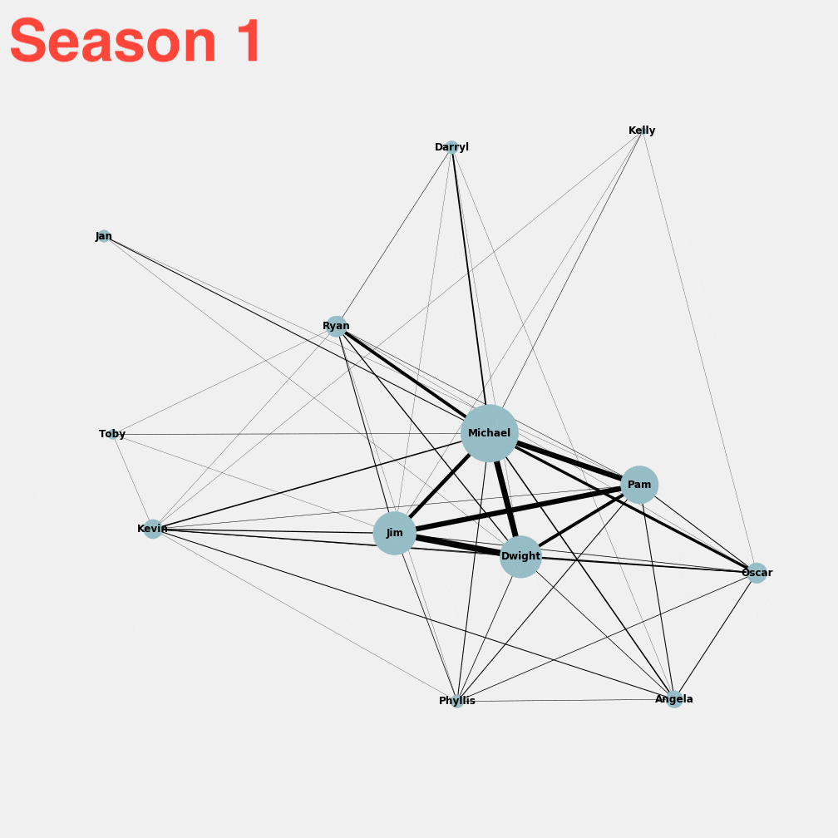
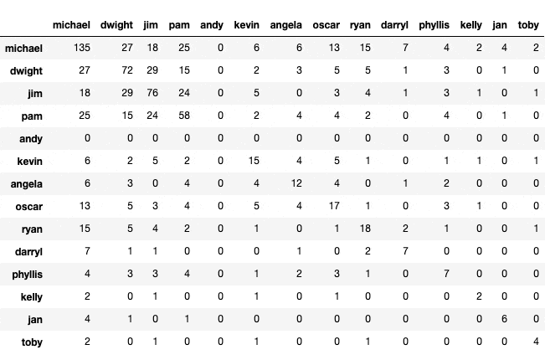
Finding interactions using character co-occurrences:
Looked at the 15 characters with the most lines
Filtered out characters who appeared in less than half the seasons

Slide 3
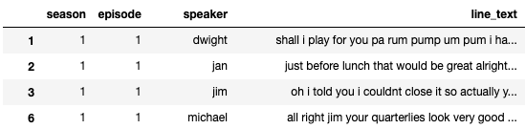
Corpus for TFIDF
Grouped all lines by character/episode
Characters needed to have a minimum length of line text to be included
LemmaTokenizer(), max/min_df NMF model

Slide 4
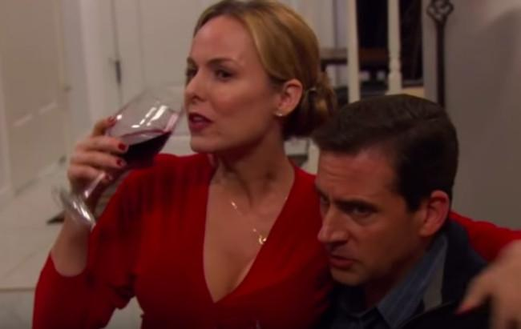
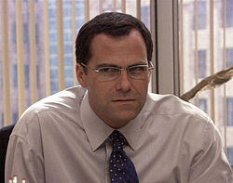
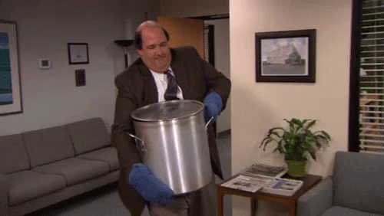
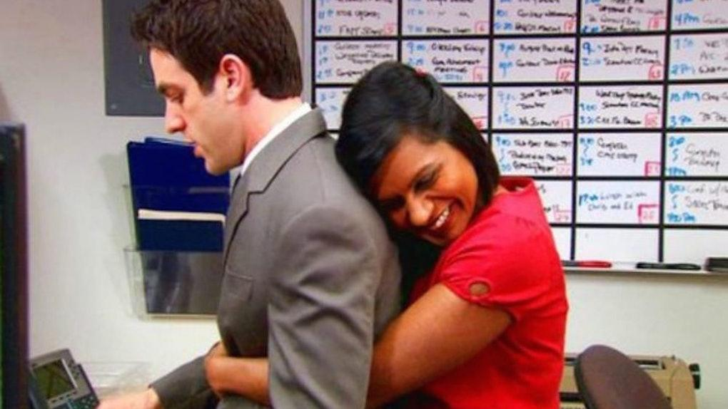
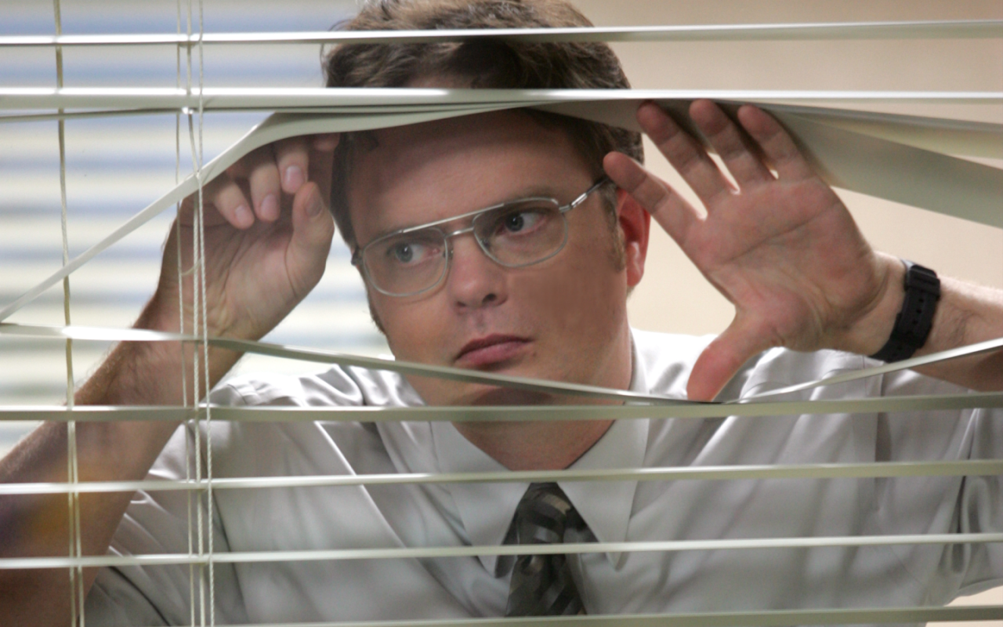
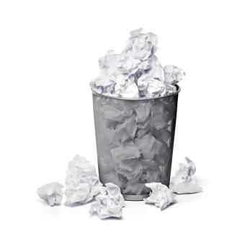
The Office Topic Modeling
Michael’s Relationships: jan, friend, woman, holly, kid, relationship, york, might, excuse, bos
Office Parties: party, christmas, phyllis, committee, planning, santa, merry, cake, birthday, gift
Corporate: paper, company, dunder, mifflin, business, client, sale, david, manager, wallace
Angela Drama: angela, oscar, wedding, phyllis, friend, wrong, woman, husband, cat
Food/Eating: kevin, hot, toby, cupcake, cookie, birthday, hand, inappropriate, oscar, pie
Ryan’s Journey: ryan, kelly, friend, howard, business, temp, married, awesome, message, fire Newborns: baby, cute, daddy, check, picture, shower, kind, night, hospital, child
Michael’s Inner Circle: mr, scott, dream, sir, true, schrute, relationship, around, halpert, bernard
(Garbage): wow, night, friend, last, darryl, cause, car, pretty, around, life

Slide 5
The Office Topic Modeling
Michael’s Relationships: jan, friend, woman, holly, kid, relationship, york, might, excuse, bos
Office Parties: party, christmas, phyllis, committee, planning, santa, merry, cake, birthday, gift
Corporate: paper, company, dunder, mifflin, business, client, sale, david, manager, wallace
Angela Drama: angela, oscar, wedding, phyllis, friend, wrong, woman, husband, cat
Food/Eating: kevin, hot, toby, cupcake, cookie, birthday, hand, inappropriate, oscar, pie
Ryan’s Journey: ryan, kelly, friend, howard, business, temp, married, awesome, message, fire Newborns: baby, cute, daddy, check, picture, shower, kind, night, hospital, child
Michael’s Inner Circle: mr, scott, dream, sir, true, schrute, relationship, around, halpert, bernard
(Garbage): wow, night, friend, last, darryl, cause, car, pretty, around, life

Slide 6
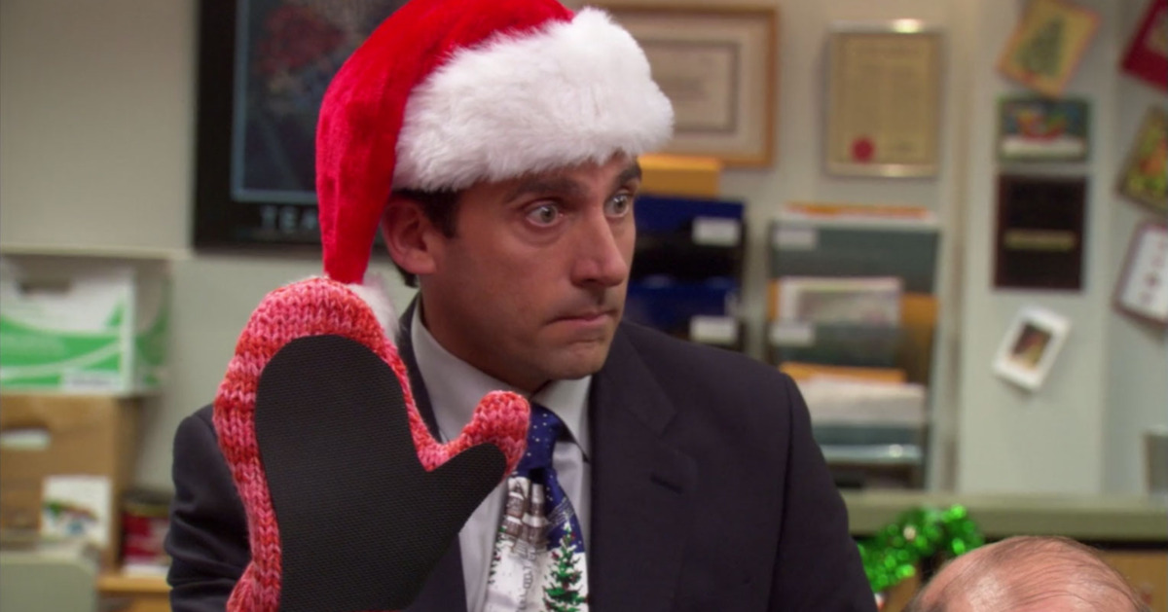
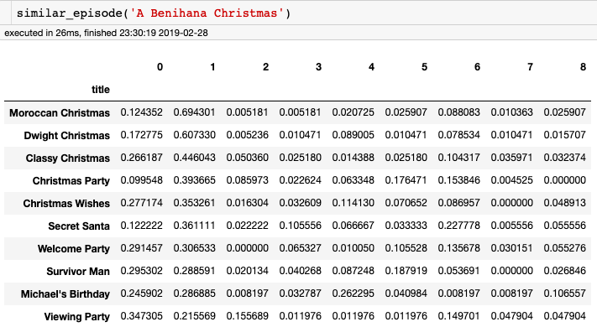
Cosine Similarity

Slide 7
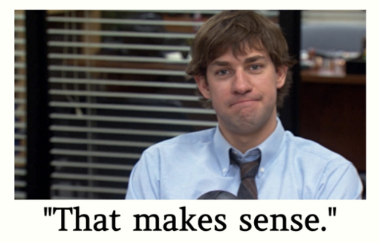
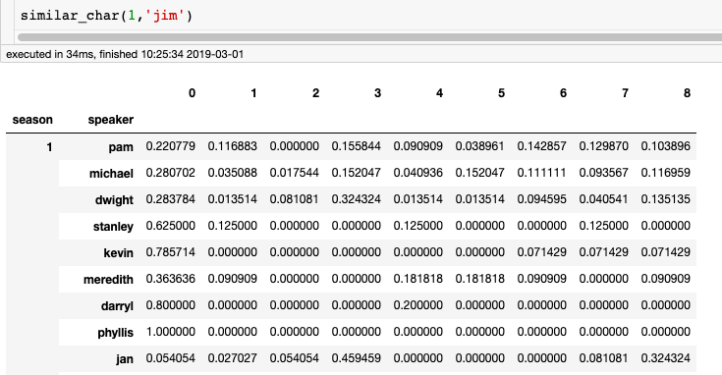
Cosine Similarity

Slide 8
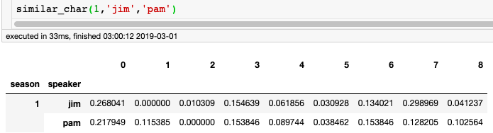
Vectorizing Pairs
char1
season
char2

Slide 9
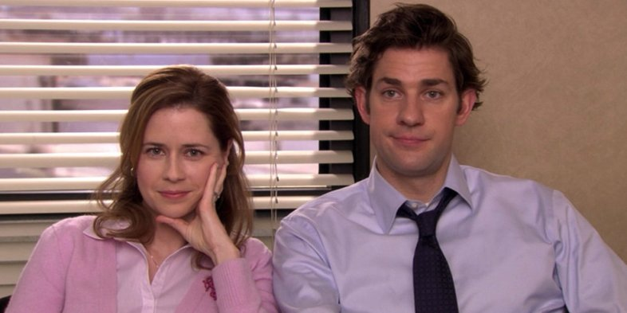
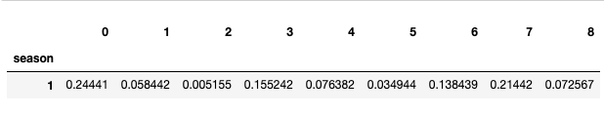
Vectorizing Pairs
char1
season
char2

Slide 10
Character Relationship Episode Recommender
(SWIPE RIGHT)

Slide 11

Thank you!

